Slide 1
Trees

Slide 2
Trees
So far we have seen linear structures
lists, vectors, arrays, stacks, queues, etc
Non-linear structure: trees
probably the most fundamental structure in computing
hierarchical structure
Terminology: from family trees (genealogy)

Slide 3

Nature View of a Tree
leaves
branches
root

Slide 4

Computer Scientist’s View
root
leaves
branches
nodes

Slide 5
Trees
root
▪
store elements hierarchically
▪
the top element: root
▪
except the root, each element has a parent
▪
each element has 0 or more children

Slide 6
Trees
▪
Definition
A tree T is a set of nodes storing elements such that the nodes have a parent-child relationship that satisfies the following
if T is not empty, T has a special tree called the root that has no parent
each node v of T different than the root has a unique parent node w; each node with parent w is a child of w
▪
Recursive definition
T is either empty
or consists of a node r (the root) and a possibly empty set of trees whose roots are the children of r

Slide 7
Trees
▪
Terminology
siblings: two nodes that have the same parent are called siblings
internal nodes
nodes that have children
external nodes or leaves
nodes that don’t have children
ancestors of a node: parent, grandparent, grand-grandparent, etc. The ancestors of a node are all the nodes along the path from the root to the node
descendants of a node: child, grandchild, grand-grandchild, etc.

Slide 8
Trees
▪
Terminology
Edge: The connection between one node and another.
Path : A sequence of nodes and edges connecting a node with a descendant.
Height of node: The height of a node is the number of edges on the longest path between that node and a leaf.
Height of tree: The height of a tree is the height of its root node.
Depth: The depth of a node is the number of edges from the node to the tree's root node.
Level :The level of a node is defined by 1 + depth

Slide 9

Trees
root
internal nodes
leaves

Slide 10

Trees
ancestors of u
u

Slide 11

Trees
descendants of u
u

Slide 12
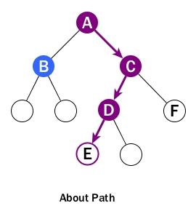
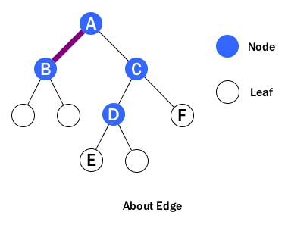
Edge – connection between one node to another.
Path – a sequence of nodes and edges connecting a node with a descendant.

Slide 13
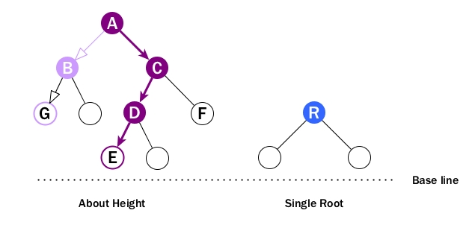
Height of node – The height of a node is the number of edges on the longest downward path between that node and a leaf.
Every node has height.
Leaf cannot have height as there will be no path starting from a leaf.
Height of the Root is the longest path from the node to a leaf. So A's height is the number of edges of the path to E, NOT to G. And its height is 3.
height of a tree is the height of its root.

Slide 14
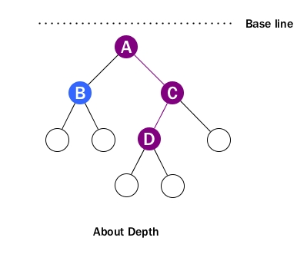
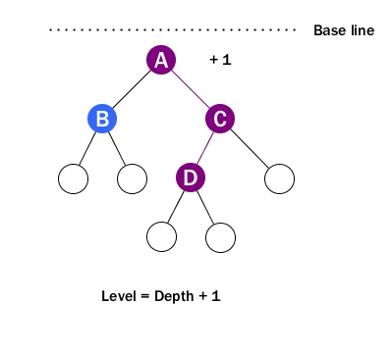
Depth –The depth of a node is the number of edges from the node to the tree's root node.
For example, D's depth is 2.
For depath, the baseline is at top which is root level. That's why we call it depth.
Note that the depth of the root is 0.
Level – The level of a node is defined by 1 + the number of connections between the node and the root.
level is depth plus 1
Level starts from 1 and the level of the root is 1.

Slide 15
Applications of Trees
Storing naturally hierarchical data
eg: file system
Organize data for quick search, insertion, deletion
eg: Binary Search Trees
Network Routing Algorithm

Slide 16
Binary Trees
A binary tree is a finite set of nodes that is either empty or consists of a root and two disjoint binary trees called the left subtree and the right subtree.

Slide 17
Samples of Trees
Complete Binary Tree
A
A
A
A
B
B
B
C
C
Skewed Binary Tree
B
C
D
D
E
F
G
D
E
F
G
E
H
I
J
K
L
M
N
O
H
I
Full binary tree of depth 4

Slide 18
Skewed Binary Tree
A good definition for a skew tree is a binary tree such that all the nodes except one have one and only one child. (The remaining node has no children.) Another good definition is a binary tree of n nodes such that its depth is n-1.
A
A
B
B
C
Skewed Binary Tree
D
E

Slide 19
Complete Binary Tree
A complete binary tree is a binary tree in which every level, except possibly the last, is completely filled, and all nodes are as far left as possible.
Complete Binary Tree
A
B
C
D
E
F
G
H
I

Slide 20
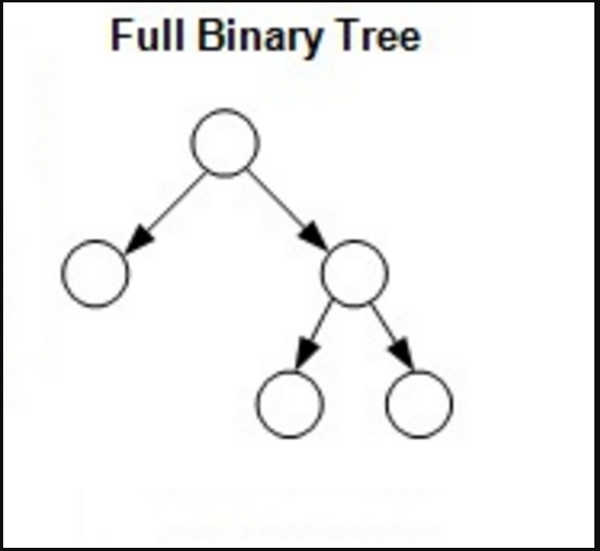
Full Binary Trees
A full binary tree (sometimes proper binary tree or 2-tree) is a tree in which every node other than the leaves has two children.
A
B
C
D
E
F
G
H
I
J
K
L
M
N
O
Full binary tree of depth 4

Slide 21
Maximum Number of Nodes in BT
The maximum number of nodes on level i of a binary tree is 2^{i-1}, i>=1.
The maximum number of nodes in a binary tree of depth k is 2^{k}-1, k>=1.

Slide 22
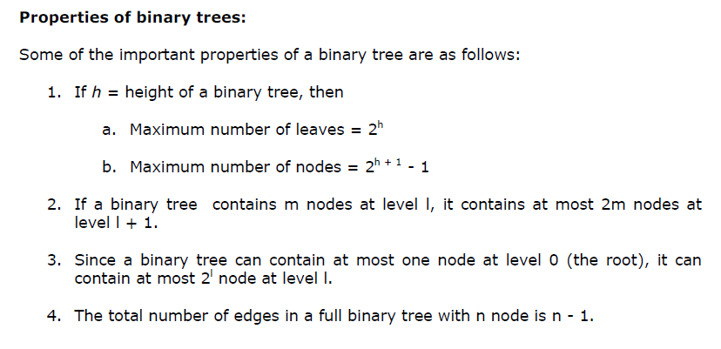

Slide 23
Binary Tree Representations
If a complete binary tree with n nodes (depth = log n + 1) is represented sequentially, then for any node with index i, 1<=i<=n, we have:
parent(i) is at i/2 if i!=1. If i=1, i is at the root and has no parent.
left_child(i) ia at 2i if 2i<=n. If 2i>n, then i has no left child.
right_child(i) ia at 2i+1 if 2i +1 <=n. If 2i +1 >n, then i has no right child.

Slide 24
Sequential Representation
[1]
[2]
[3]
[4]
[5]
[6]
[7]
[8]
[9]
A
B
C
D
E
F
G
H
I
(1) waste space
(2) insertion/deletion
problem
A
[1]
[2]
[3]
[4]
[5]
[6]
[7]
[8]
[9]
.
[16]
A
B
--
C
--
--
--
D
--
.
E
B
A
C
B
C
D
D
E
F
G
E
H
I

Slide 25
Linked Representation
typedef struct node *tree_pointer;
typedef struct node {
int data;
tree_pointer left_child, right_child;
};
data
left_child
data
right_child
left_child
right_child

Slide 26
Traversing Binary Trees
Preorder (for each sub-tree with root R, perform following steps recursively) (NLR node-left-right)
1. Process root node R
2. traverse left sub-tree of R
3. traverse right sub-tree of R
Inorder (for each sub-tree with root R, perform following steps recursively) (LNR left-node-right)
1. traverse left sub-tree of R
2. Process root node R
3. traverse right sub-tree of R
Postorder (for each sub-tree with root R, perform following steps recursively) (LRN left-right-node)
1. traverse left sub-tree of R
2. traverse right sub-tree of R
3. Process root node R

Slide 27
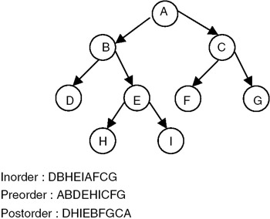
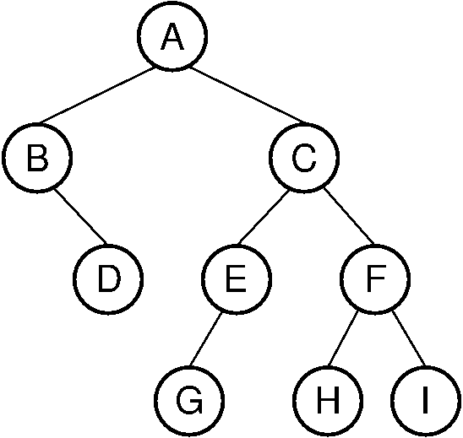
Traversing Trees
Do it yourself

Slide 28
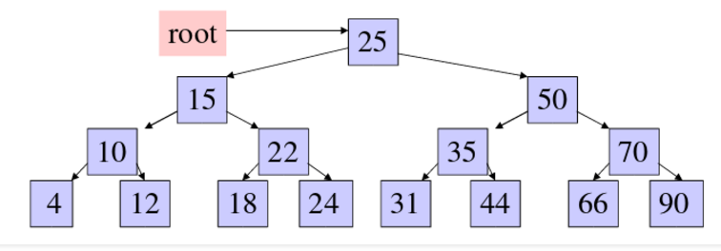
Exercises
Find the inorder, preorder and postoder of the tree.

Slide 29
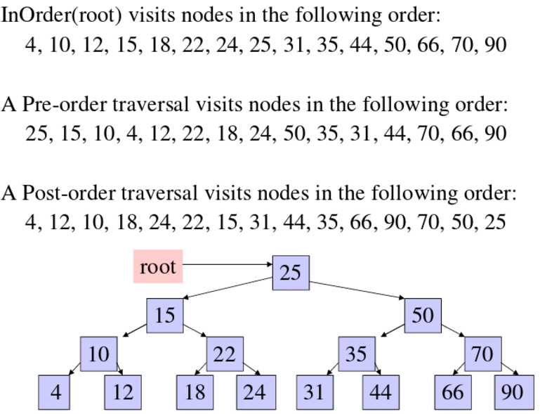
Exercises

Slide 30
Pre-order Traversing Algorithm (basic ideas)
1. set PTR = ROOT
2. PUSH null (-1) onto Stack
3. repeat a, b while PTR !=NULL
a) while (LEFT(PTR)!= Null)
1) process each node, N
2) If N has a right child, RIGHT(N), push RIGHT(N) into the Stack
3) do the above (step: 1, 2) until L(N) is found: LEFT(PTR) != NULL. Set PTR= LEFT(PTR)
b) (backtracking): PTR = POP(STACK). Repeat step a) if (PTR != null) else exit.

Slide 31
Pre-order traversing
Preordertraverse(Info, Left, Right, Root)
1. // push null to Stack and initialize current pointer to root
Top=1, Stack[Top]=null and PTR=Root // here null=0, array index begins from 1. index 0 is ignored
2. Repeat step 3 to 5 while (PTR ! = null)
3. Process Info[PTR] // any process: print… etc.
4. // check right child
if Right[PTR] ! = null
top++ and Stack[Top]=Right[PTR] // push to stack
5. // child left child
if Left[PTR] != null
PTR= Left[PTR]
else
PTR= Stack[Top] and Top-- // pop from stack
// end of step 3 loop
6. Exit

Slide 32
In-order traversing
Inorder_traverse(Info, Left, Right, Root)
1. // push null to Stack and initialize current pointer to root
Top=1, Stack[Top]=null and PTR=Root // here null=0, array index begins from 1. index 0 is ignored
2. Repeat step 2 while (PTR ! = null) // push left most path to stack
top++ ; Stack[Top]=PTR ; PTR= Left[PTR]
3. PTR= Stack[Top] and Top-- // pop from stack
4. Repeat step 5 to 7 while (PTR ! = null)
5. Process Info[PTR] // any process: print… etc.
6. // check right child
if Right[PTR] ! = null
PTR= right[PTR]
go to step 2
7. PTR= Stack[Top] and Top--
// end of step 4 loop
8. Exit

Slide 33
Post-order traversing
Postorder_traverse(Info, Left, Right, Root)
1. // push null to Stack and initialize current pointer to root
Top=1, Stack[Top]=null and PTR=Root // here null=0, array index begins from 1. index 0 is ignored
2. Repeat step 3 to 5 while (PTR ! = null)
3. top++ ; Stack[Top]=PTR ; // push to stack
4. If Right[PTR] != null
top++ ; Stack[Top]=-Right[PTR] ; // push negative value of right child index to stack
5. PTR= Left[PTR]
6. PTR=Stack[Top]; Top--; // pops from stack
7. Repeat step 7 while (PTR>0)
Process Info[PTR] // any process: print… etc.
PTR=Stack[Top]; Top--
8. if PTR<0
PTR= - PTR
go to step 2
9. Exit

Slide 34
Construct Tree from given Inorder and Preorder traversals
Construct Tree from given Inorder and Preorder traversals
Thoughts: Let us consider the below traversals:
Inorder sequence: D B E A F C Preorder sequence: A B D E C F

Slide 35
Construct Tree from given Inorder and Preorder traversals(continue)
In a Preorder sequence, leftmost element is the root of the tree. So we know ‘A’ is root for given sequences. By searching ‘A’ in Inorder sequence, we can find out all elements on left side of ‘A’ are in left subtree and elements on right are in right subtree. So we know below structure now.

Slide 36
Construct Tree from given Inorder and Preorder traversals(continue)
A
/ \
/ \
DBE FC
We recursively follow above steps and get the following tree.
A
/ \
B C
/ \ /
D E F

Slide 37
Construct a Binary Tree from Postorder and Inorder
In[] = {4,8,2,5,16,3,7}
Post[] = {8,4,5,2,6,7,3,1}

